Slide 1



CAMPUS KART RACING GAME
Team Members:
Buğra DOĞAN
Esra ŞAHİN
Ozan ÇETİNER
N. Cem ALTUNBULDUK
Advisor:
Murat SARAN

Slide 2

CONTENTS
objectives
defınıtıons
sımılar projects
cross-platform consıderatıons
game launchıng
technologıes used
modellıng envıronment
methods used
potentıal rısks
plannıng
project work plan

Slide 3
Objectives
CROSS-PLATFORM RACING GAME
SINGLE PLAYER MODE
MULTIPLAYER MODE
CAR CUSTOMIZATION

Slide 4
DEFINITIONS
NON PLAYABLE CHARACTERS (NPC)
GAME ENGINE
CROSS PLATFORM GAMES
PHOTON UNITY NETWORKING (PUN)

Slide 5
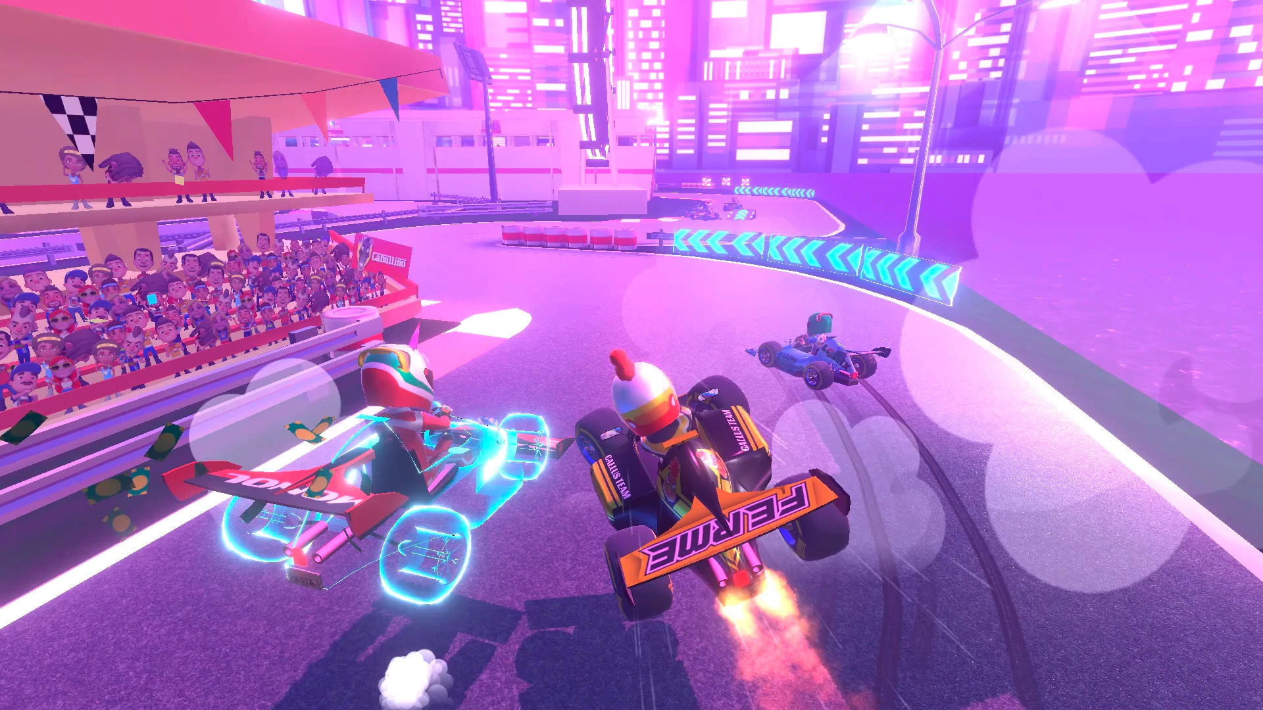
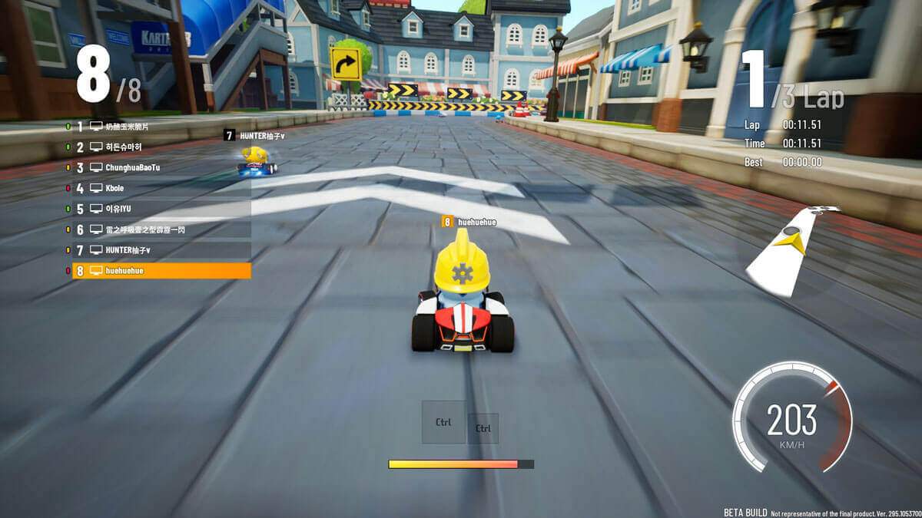
SIMILAR PROJECTS
Touring karts(2019, Ivanovıc games) Kartrider: Drift(2020, nexon korea)
Windows
iOS
Android
PS4
Switch
Windows
Xbox One
Android

Slide 6
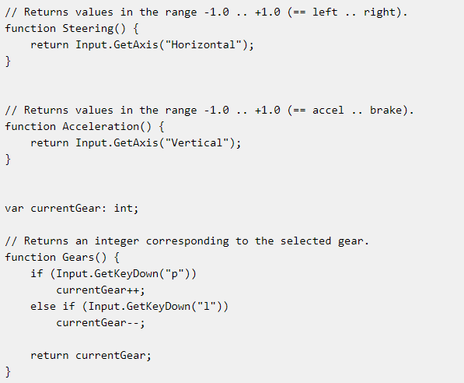
CROSS-PLATFORM CONSIDERATIONS
Keyboard and joypad
Memory, storage and cpu performance

Slide 7


GAME LAUNCHING
Open source code
Setup file accessible on github and website
Payment information
Tax information
Product shipping fee
Unity Configuration

Slide 8






TECHNOLOGIES USED
Unity 3D
Visual Studio
3Ds Max
Blender
Adobe Photoshop
Adobe Illustrator

Slide 9
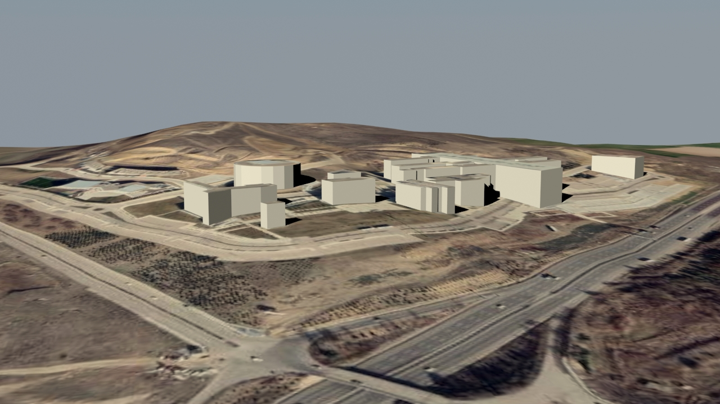
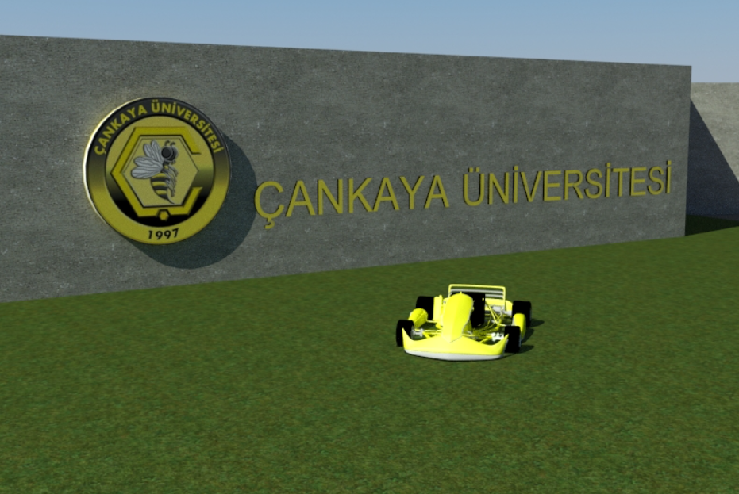
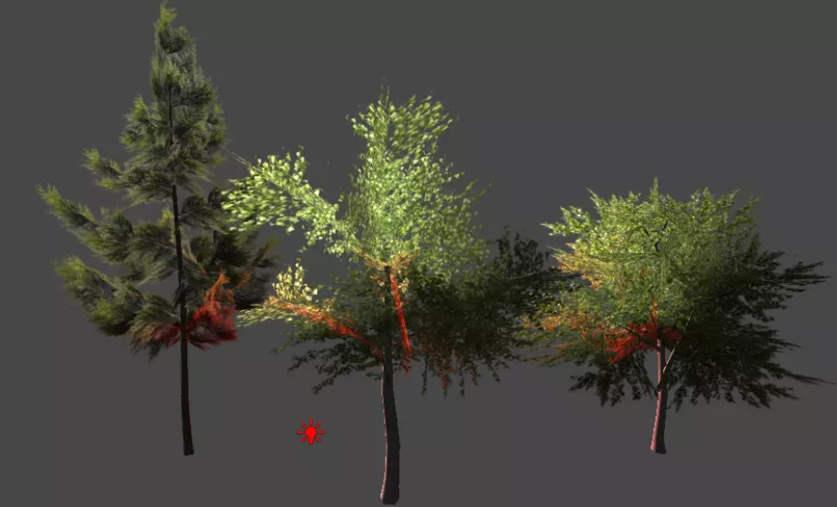
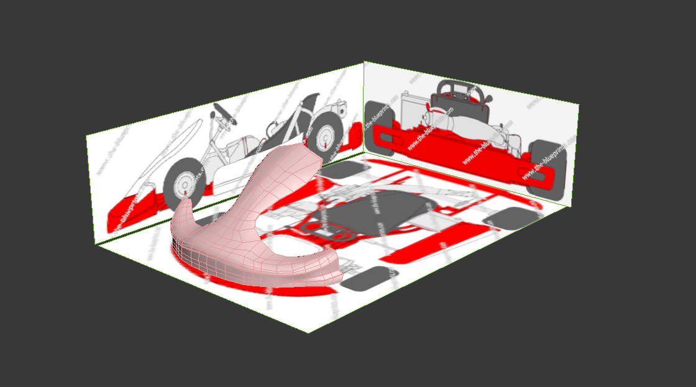
MODELLING ENVIRONMENT
1.
2.
3.
4.

Slide 10
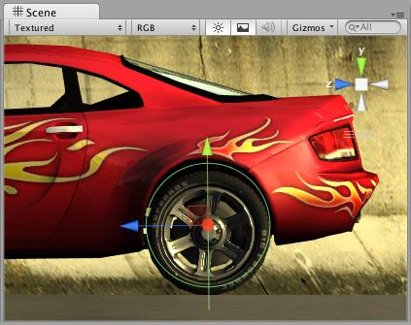
METHODS USED
FOR MOVEMENT
RIGIDBODY
Some propertıes:
angular Drag
angular Velocity
Center Of Mass
mass
velocity
...
WHEEL COLLIDER
Some propertıes:
Mass
Radıus
Suspensıon Dıstance
Center
...

Slide 11

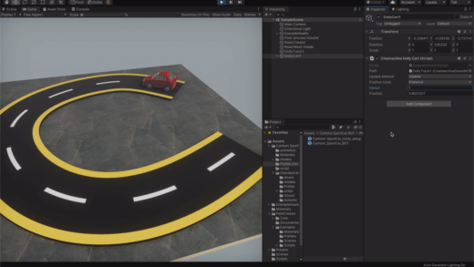
METHODS USED
FOR AI
1 - NAVMESH (Unity AI System)
2 - PATH FOLLOW
1.
2.

Slide 12
POTENTIAL RISKS
RISKS | SOLUTION
PING | DIFFERENT SERVERS
FPS | SETTINGS(RESOLUTION,TEXTURE QUALITY ETC.)

Slide 13
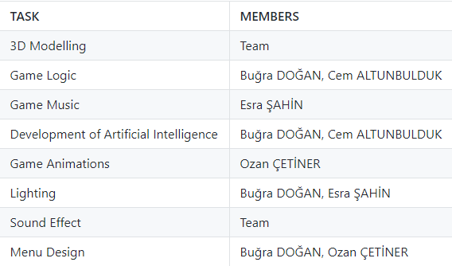
PLANNING

Slide 14
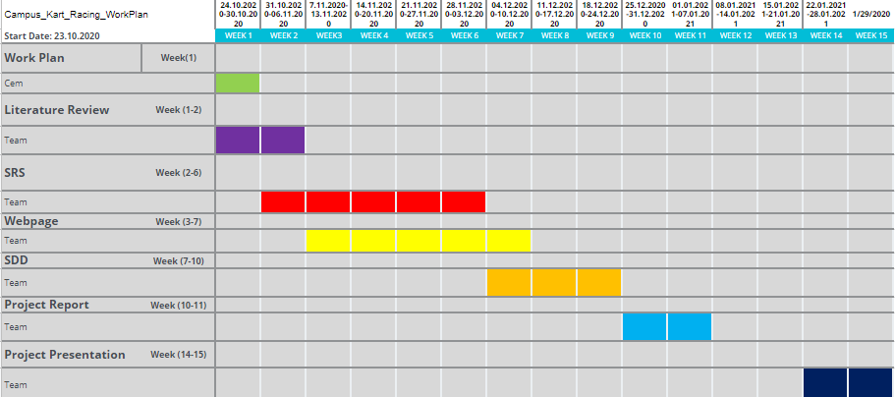
PROJECT WORK PLAN
Gantt Chart of CENG407

Slide 15
THANK YOU.

